Slide 1
Gramene: An Integrated Phylogenomics Resource for the Oryza Genus
ISRFG9
Taipei, Taiwan
11/7/11
Joshua Stein

Slide 2
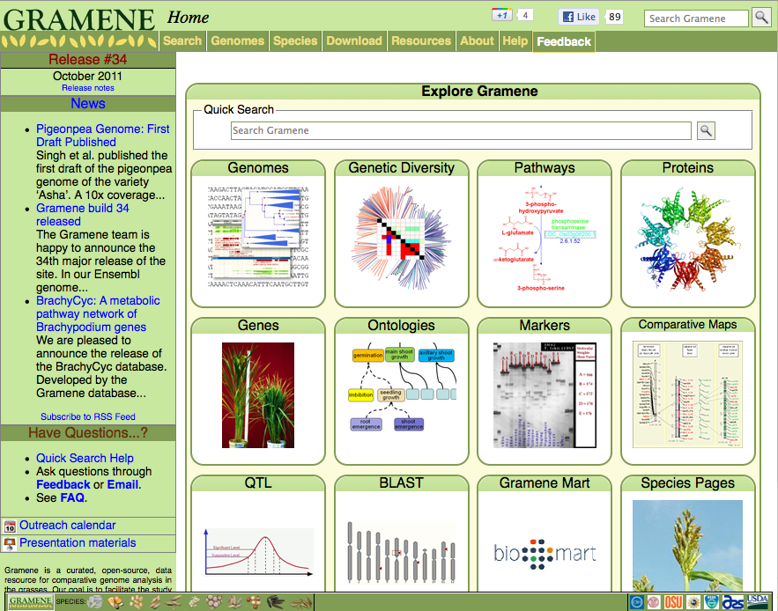







www.gramene.org
Doreen Ware
Pankaj Jaiswal
Susan McCouch
Ed Buckler
Lincoln Stein
Comparative genomics platform established in 2000 with the release of the rice genome
Now includes 14 complete reference genomes
Genome browsers, Pathways, Diversity, Comparative Maps, Germplasm, and Ontologies
Integrated within a Comparative Genomics framework

Slide 3
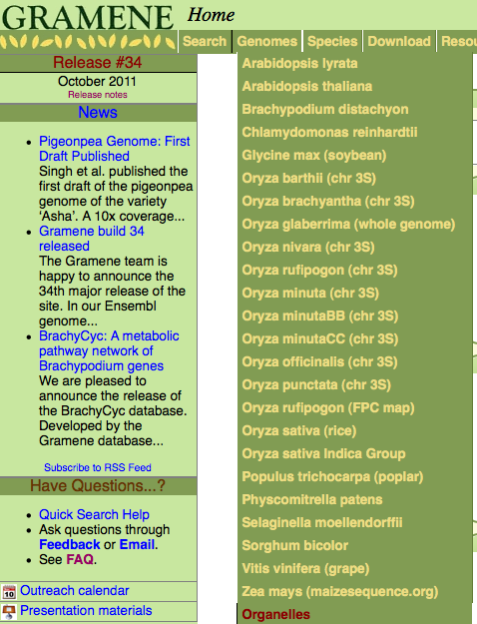
Gramene Release 34
6 Grasses
5 Eudicots
Selaginella moellendorfii
Physcomitrella patens
Chlamydomonas

Slide 4
OMAP, I-OMAP, Oryza Genome Evolution (OGE)
Public access data
Baseline annotation of genes & protein structure
Display & visualization of structural and functional annotations
DNA-level comparisons by Whole Genome Alignment
Gene evolutionary histories by phylogenetic trees
Display & visualize Transcriptome and Diversity Data

Slide 5
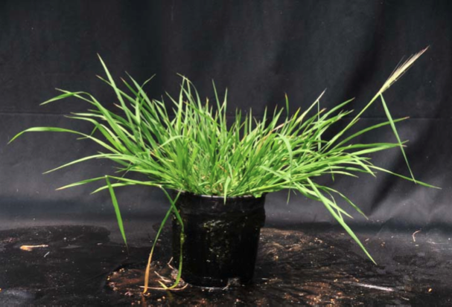
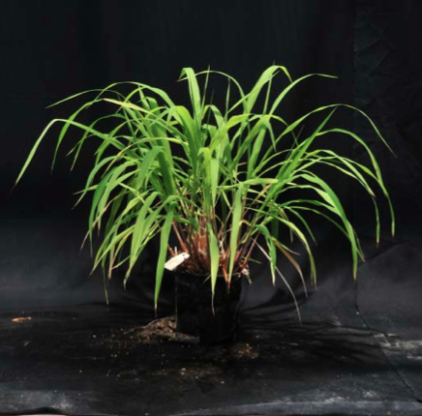
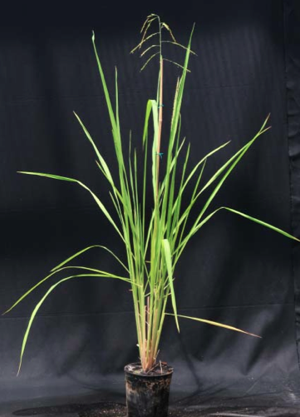
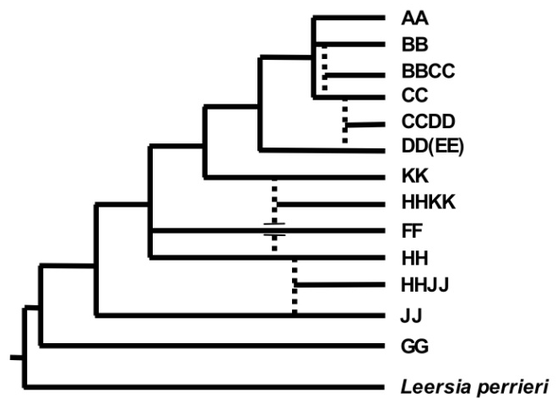
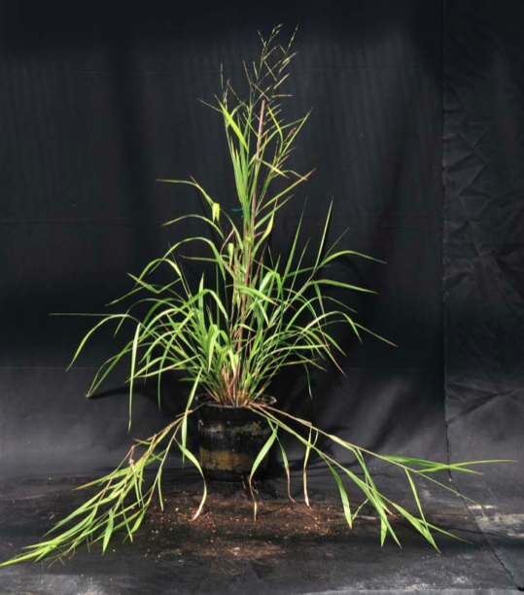
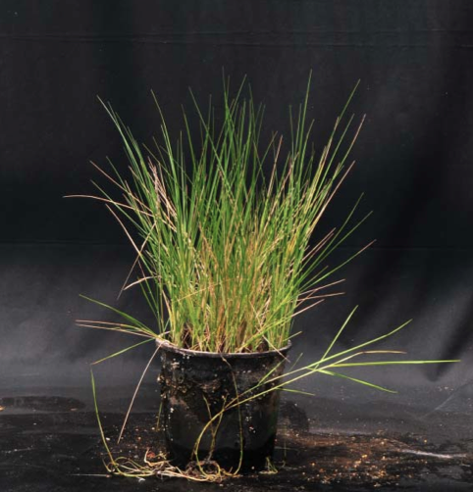
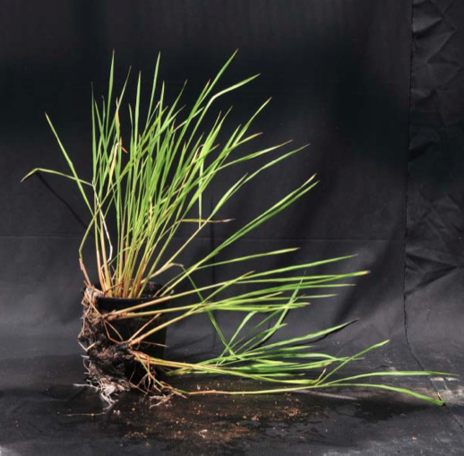
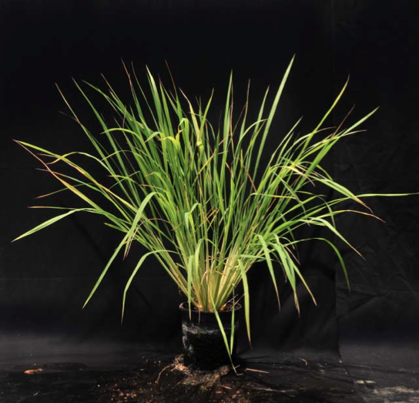
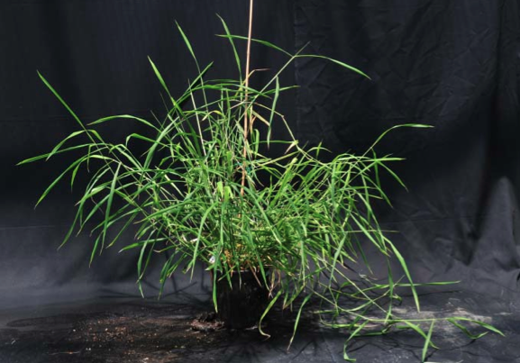
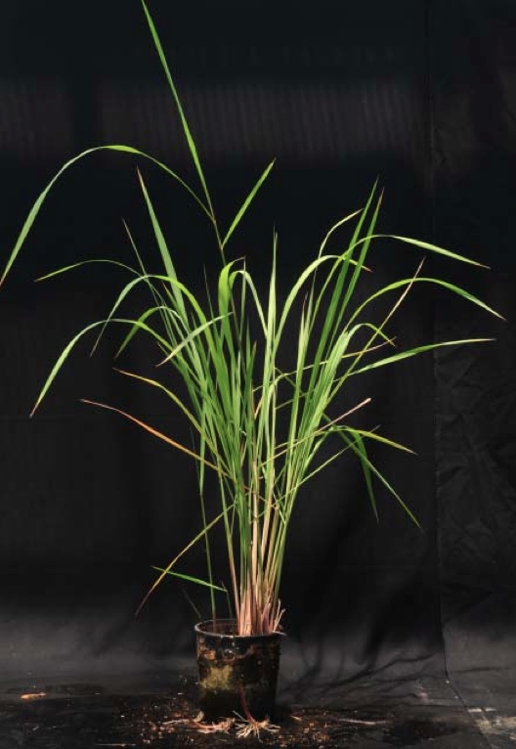
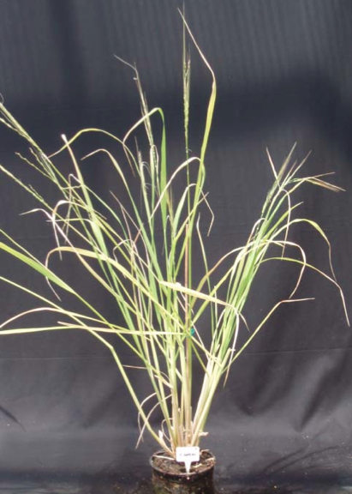
Oryza Genus Diversity
23 species
10 Genome types
Allotetraploids

Slide 6
Oryza in Gramene
Type | Species | Complete reference | Chr 3 short arm | Physical maps (OMAP)
AA | *O. sativa ssp japonica | IRGSP/TIGR/MSU
 | *O. sativa ssp indica | BGI
 | *O. nivara | Y. Hsing - Taiwan | AGI | AGI
 | *O. rufipogon | B. Han - NCGR,PRC | AGI | AGI
 | *O. glaberrima | R. Wing - AGI |  | AGI
 | O. barthii | R. Wing - AGI | AGI
 | *O. longistaminata | W. Wang - PRC/BGI
 | O. glumaepatula | A. de Oliveira - UP, Brazil | AGI
 | O. meridionalis | O. Panaud - UP, France | AGI
BB | O. punctata | R. Wing - AGI | AGI | AGI
CC | O. eichingeri | N. Kurata - NIG, Japan
 | O. officinalis |  | AGI | AGI
 | O. rhizomatis
BBCC | O. minuta |  | AGI | AGI
CCDD | O. alta |  |  | AGI
 | O. grandiglumis
 | O. latifolia
EE | O. australiensis | O. Panaud - UP, France |  | AGI
HHKK | O. schlechteri
FF | *O. brachyantha | M. Chen - CASB/BGI/PRC | AGI | AGI
HHJJ | O. longiglumis
 | O. ridleyi |  |  | AGI
GG | O. granulata |  | AGI | AGI
 | O. meyeriana
 | O. neocaledonica
Outgroup | Leeresia perrieri |  | AGI

Slide 7
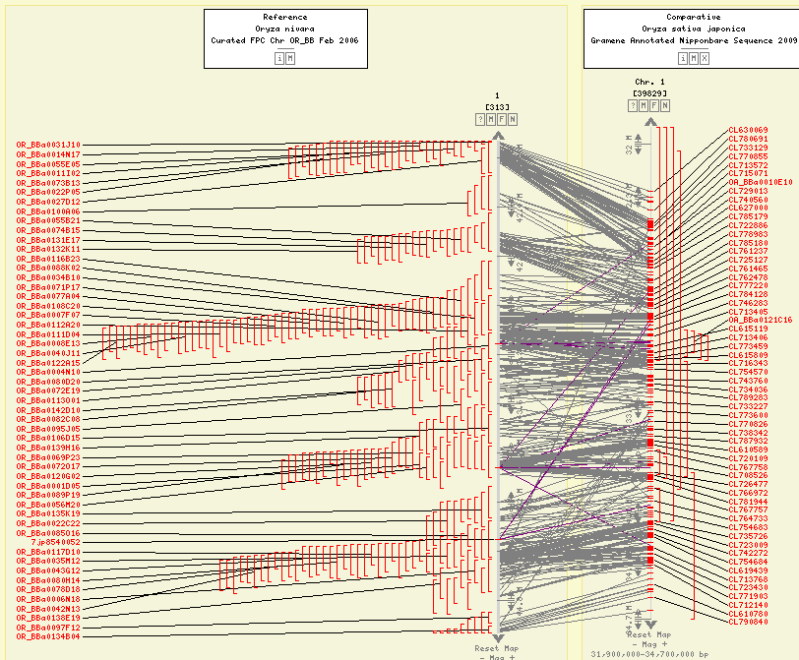
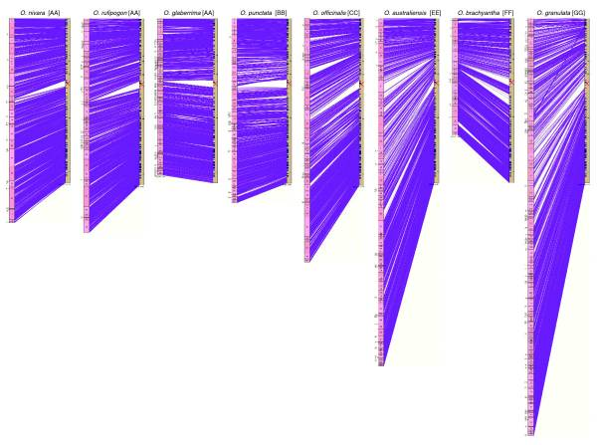
OMAP Physical Maps
CMap Comparative Maps
Each OMAP FPC map aligned to O. sativa ssp. japonica
BAC-end, overgo, other sequence-tagged markers
Interactive
Kim et al. Genome Biol. 2008; 9(2): R45.
Youens-Clark et al. Bioinformatics. 2009 Nov 15;25(22):3040-2

Slide 8
Oryza Species | Gene Annotation | Repeat Mask | Whole Genome Alignments | EST/markers alignment | InterPro/GO/dbXref | Phylogenetic Trees | Diverstiy | RNA-seq
Oryza sativa ssp. japonica | MSU 6.0 | yes | all reference genomes | yes | yes | yes | yes | no
Oryza sativa ssp. indica | BGI Glean | yes | japonica, Arabidopsis, Brachypodium | yes | yes | yes | yes | no
Oryza glaberrima | MIPS* Fgenesh | yes | japonica | yes | yes | yes | soon | yes
Chr 3 short arms | Fgenesh | yes | japonica | yes | no | yes | no | no
*Klaus Meyer, Thomas Wicker MIPS Germany

Slide 9
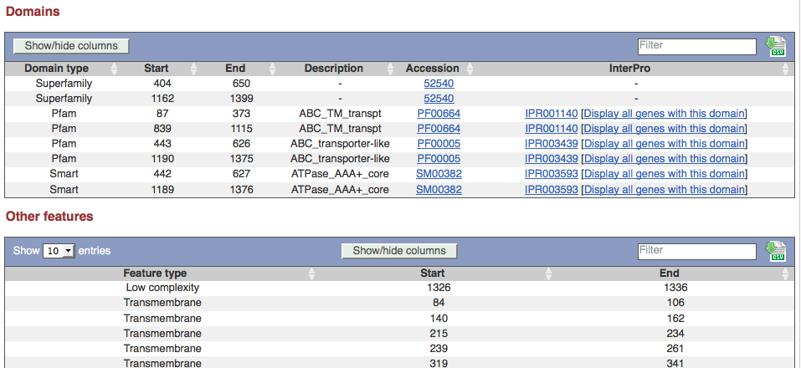
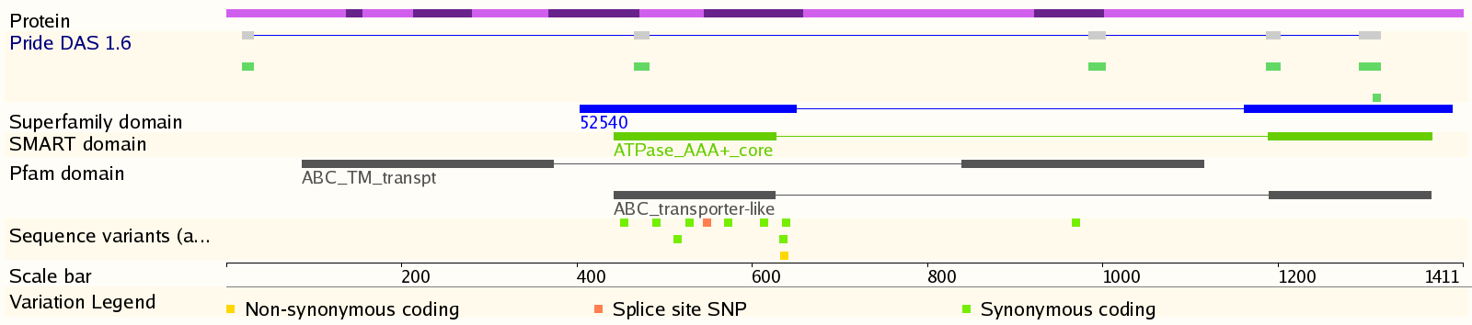
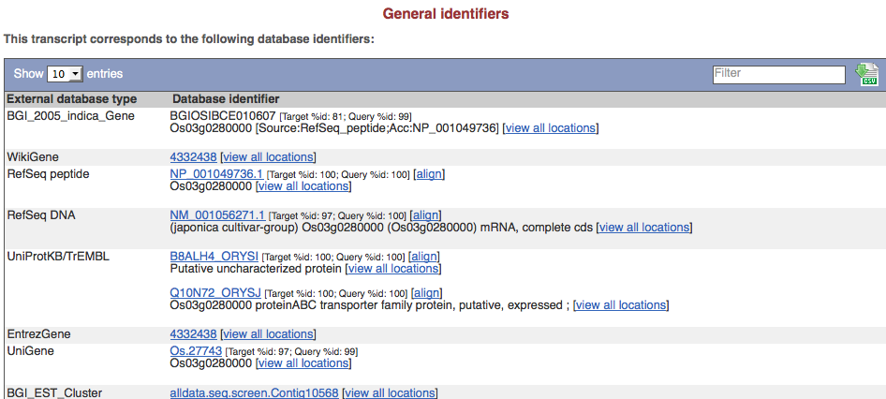
InterPro/dbXref/GO
Structural prediction: Pfam, PIRSF, PRINTS, PROSITE, SMART, SUPERFAMILY, TIGRFAM, TMHMM, SignalP
Cross-reference genes to 3rd party identifiers: Entrez Gene, PlantGDB, PUTs, RefSeq, Gene Index, UniGene, UniProt
Gene Ontology

Slide 10
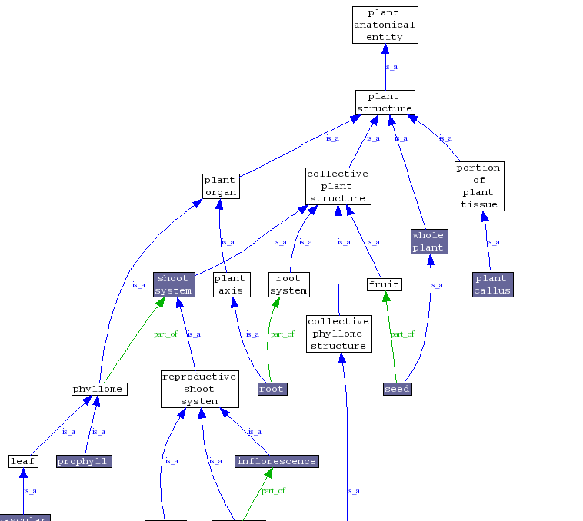
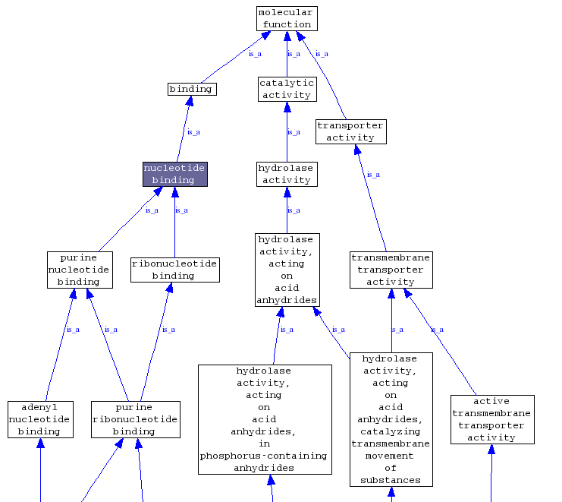
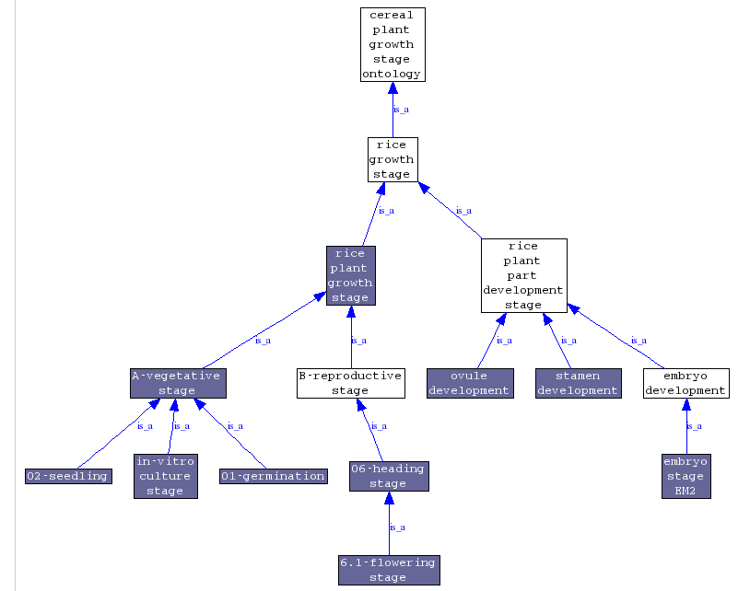
Ontologies
Gene Ontology
Plant Ontology
Growth Stage Ontology
Graphical and tabular views
LOC_Os03g17180.1

Slide 11
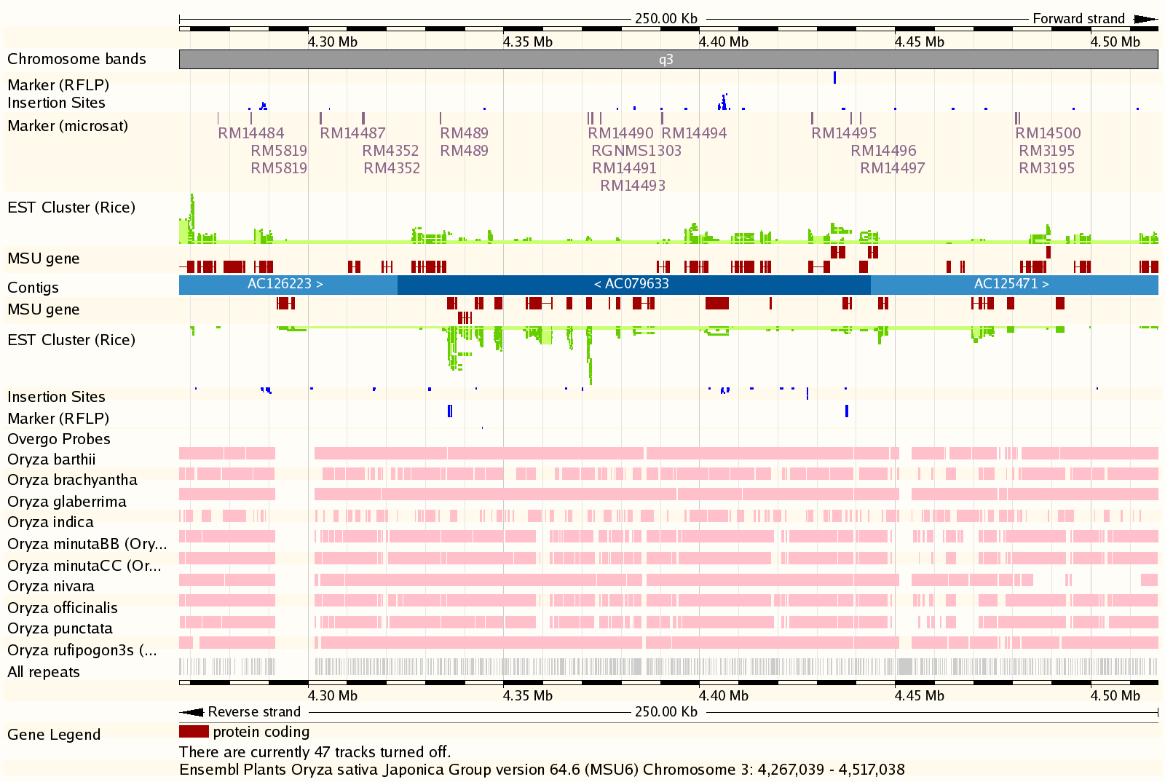
Whole Genome Alignment BLASTZ-CHAIN-NET
Notes:
http://www.gramene.org/Oryza_sativa/Location/View?r=3:3380650-3403426#r=3:4267039-4517038

Slide 12
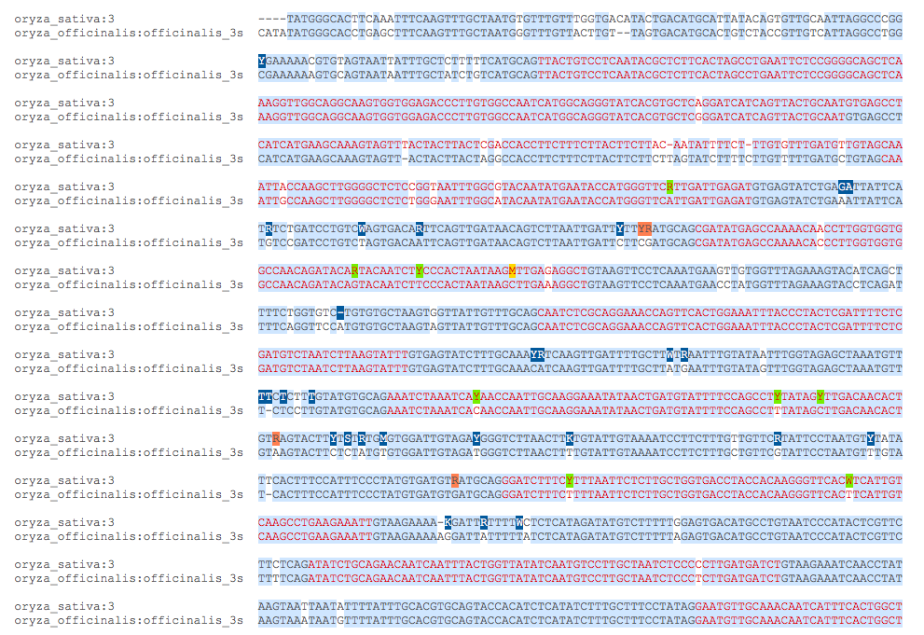
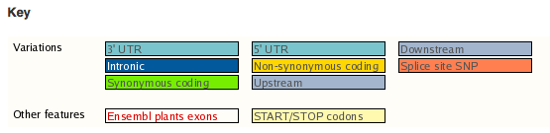
Sequence-level View

Slide 13
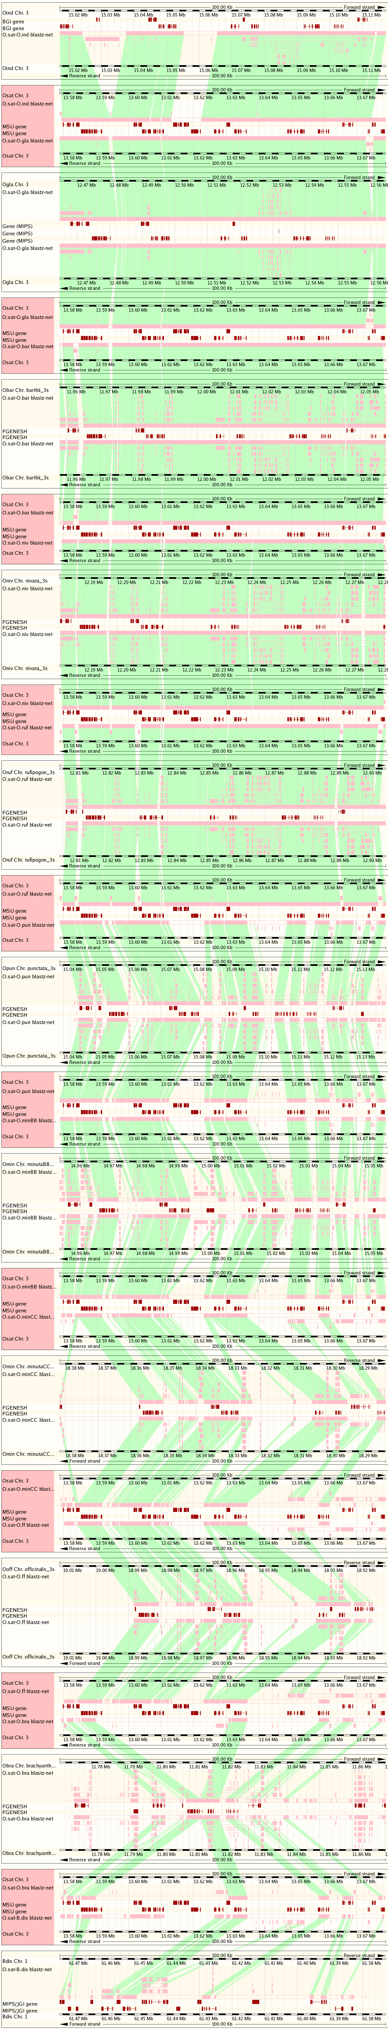
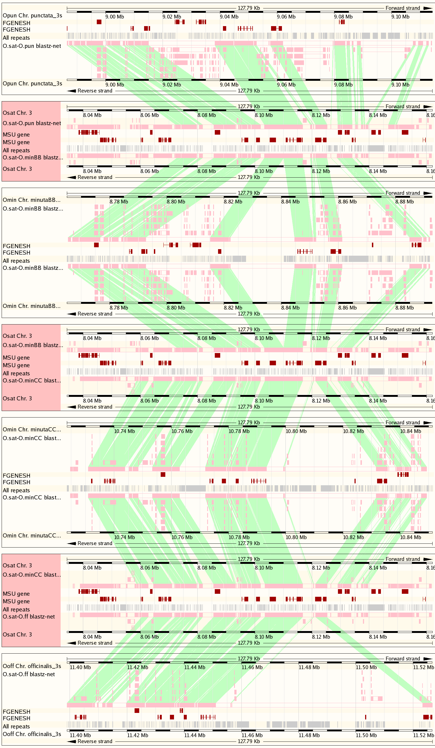
Multi-species View
indica
O. sativa
O. punctata (BB)
O. glaberrima (AA)
O. sativa
O. barthii (AA)
O. sativa
O. sativa
O. nivara (AA)
O. sativa
O. minuta (BB)
O. rufipogon (AA)
O. sativa
O. sativa
O. punctata (BB)
O. sativa
O. minuta (BB)
O. minuta (CC)
O. sativa
O. minuta (CC)
O. sativa
O. sativa
O. officinalis (CC)
O. sativa
O. brachyantha (FF)
O. officinalis (CC)
O. sativa
Brachypodium distachyon

Slide 14
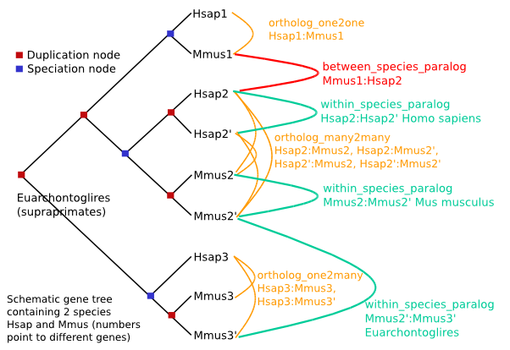
Compara Gene Trees
Reconstructing evolutionary histories
Include all plant reference genomes plus human, ciona, fly, worm, yeast
Infers orthologues and paralogues by reconciling gene tree with input species tree
Taxonomic dating of each duplication node
Vilella A.J., et al. (2008). Genome Res.
http://useast.ensembl.org/info/docs/compara/homology_method.html

Slide 15
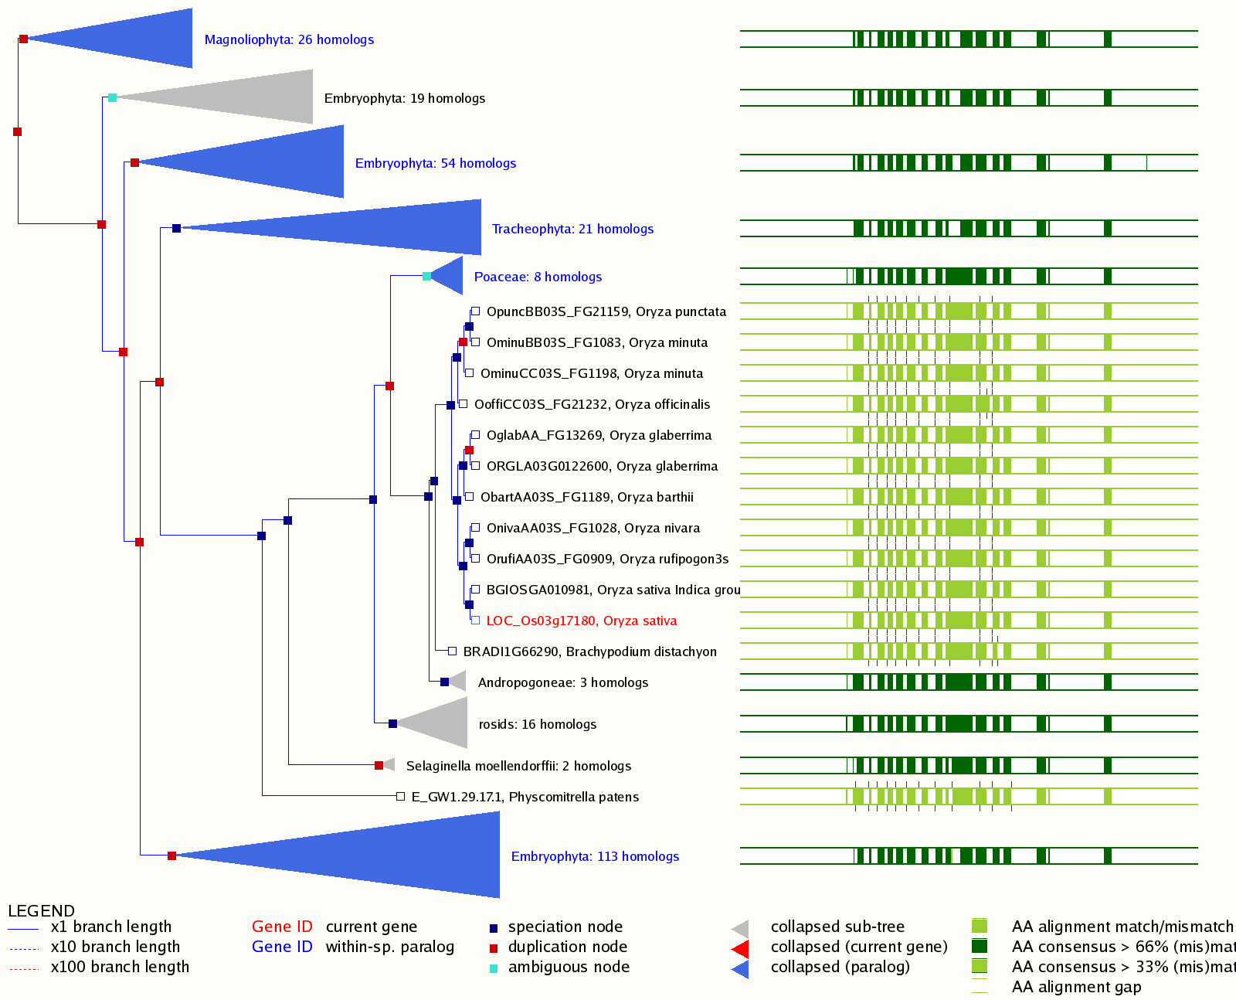
Notes:
http://www.gramene.org/Oryza_sativa/Gene/Compara_Tree?collapse=1370785%2C1370826%2C1370493%2C1370861%2C1370994%2C1370535%2C1370781%2C1370896%2C1370801;db=core;g=LOC_Os03g17180;r=3:9556395-9565462;t=LOC_Os03g17180.1

Slide 16
Newick tree & alignment
(((ENSCINP00000002474_Cint_:0.0000,
R10D12.12_Cele_:3.4477):0.7716,
FBpp0084782_Dmel_:0.8566):0.0000,
(((((BRADI3G43170.1_Bdis_:0.0615,
BRADI2G38000.1_Bdis_:0.1536):0.0214,
((LOC_Os02g26814.1_Osat_:0.0000,
BGIOSGA008178-PA_Oind_:0.0000):0.0000,
ORGLA02G0140900.1_Ogla_:0.0000):0.0938):0.0231,
(((GRMZM2G050705_P02_Zmay_:0.0099,
GRMZM2G124671_P01_Zmay_:0.0745):0.0043,
Sb08g016480.1_Sbic_:0.0348):0.0000,
(GRMZM2G022470_P01_Zmay_:0.0475,
Sb04g017490.1_Sbic_:0.1037):0.0000):0.0917):0.1118,
(((POPTR_0005s03870.1_Ptri_:0.0420,
POPTR_0013s02650.1_Ptri_:0.0427):0.0918,
(GSVIVT01006266001_Vvin_:0.0342,
GSVIVT01000019001_Vvin_:0.0817):0.1210):0.0363,
((scaffold_702792.1_Alyr_:0.0043,
scaffold_603852.1_Alyr_:0.0632):0.0277,
AT4G16710.1_Atha_:0.0204):0.2813):0.1261):0.5081,
E_GW1.232.43.1_Ppat_:0.3698):0.3605):0.0000;
ORGLA02G0140900.1_Ogla_ VFVTVGTTCF DALVKAVDSP QVKEALLEKG YTDLIIQMGR GTY-------
BRADI2G38000.1_Bdis_ VFVTVGTTCF DALVKAVDSE EVKQALLRKG YTDLLIQMGR GTY-------
GRMZM2G050705_P02_Zmay_ VFVTVGTTCF DALVMAVDSP EVKKALLQKG YSNLLIQMGR GTY-------
POPTR_0005s03870.1_Ptri_ VFVTVGTTLF DALVRTVDTK EVKQELLRNG YTHLIIQMGR GSY-------
GRMZM2G022470_P01_Zmay_ VFVTVGTTCF DALVMAVDSP EVKKTLLQKG YSNLLIQMGR GTY-------
BRADI3G43170.1_Bdis_ VFVTVGTTCF DALVKKVDSP QVKEALWQKG YTDLFIQMGR GTY-------
GSVIVT01006266001_Vvin_ VFVTVGTTCF DALVKAVDTQ EFKKELSARG YTHLLIQMGR GSY-------
Sb08g016480.1_Sbic_ ---------- ----MAVDSP EVKMALLQKG YSNLLIQMGR GTY-------
GRMZM2G124671_P01_Zmay_ VFVTVGTTCF DALVMAVDSP EVKKALLQKG YSNLLIQMGR GTY-------
Sb04g017490.1_Sbic_ ---------- ----MAVASP EVKKALLQKG YSNLVIQMGR GTY-------
BGIOSGA008178-PA_Oind_ ---------- ---------- ---------- ---------- ----------
E_GW1.232.43.1_Ppat_ VLVTVGTTLF DALVREASSQ PCRQVLADFG YSSLVIQRGK GSF-------
scaffold_702792.1_Alyr_ VFVTVGTTSF DALVKAVVSE DVKDELQKRG FTHLLIQMGR GIF-------
R10D12.12_Cele_ ---------- ---------- ---------- ---------- ---NQDVIDR
ENSCINP00000002474_Cint_ IFVTVGTTSF DELTETITSK PVQKVLQSQG YDKVTIQYGR GKH-------
scaffold_603852.1_Alyr_ VFVTVGTTSF DALVKAVVSE DVKDELQKRG FTHLLIQMGR GNF-------
AT4G16710.1_Atha_ VFVTVGTTSF DALVKAVVSQ NVKDELQKRG FTHLLIQMGR GIF-------
LOC_Os02g26814.1_Osat_ VFVTVGTTCF DALVKAVDSP QVKEALLEKG YTDLIIQMGR GTY-------
GSVIVT01000019001_Vvin_ VFVTVGTTCF DALVKAVDTH EFKRELFARG YTHLLIQMGR GSY-------
FBpp0084782_Dmel_ VYITVGTTKF DALISTASTE PALKALQNRK CTKLVIQHGN SQP-------
POPTR_0013s02650.1_Ptri_ VFVTVGTTLF DALVRTVDTK EVKQELLRKG YTDLVIQMGR GSY-------

Slide 17
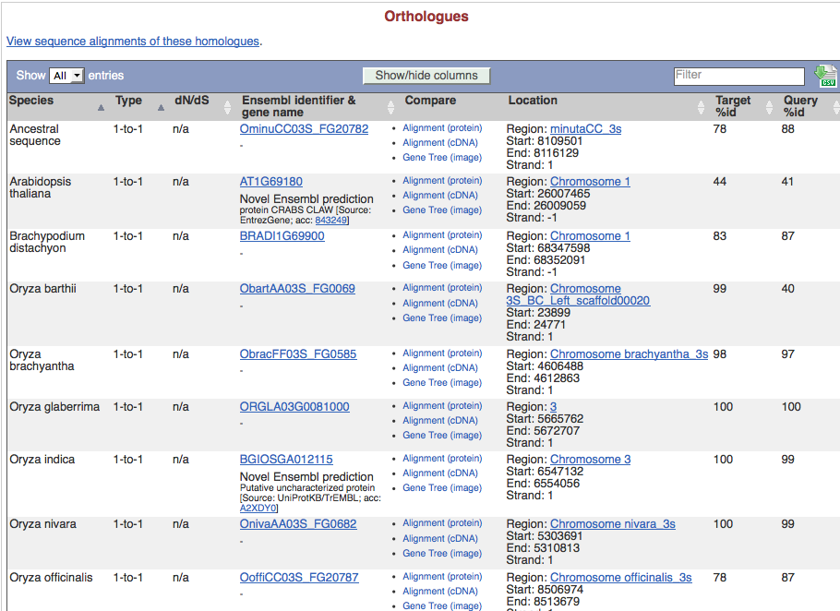
Ortholog Calls
Gene: DL (LOC_Os03g11600)

Slide 18
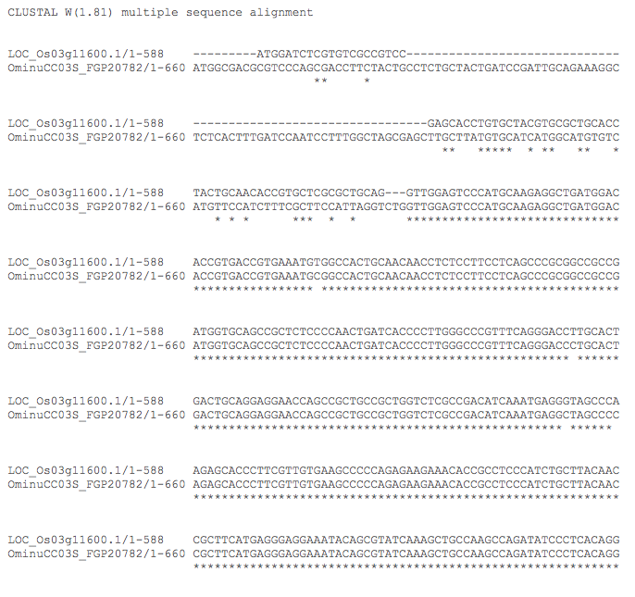
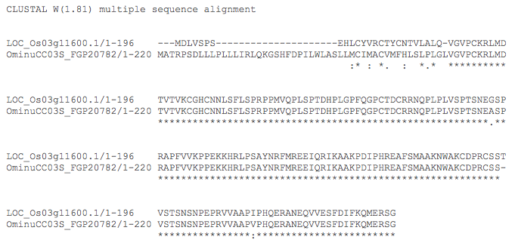
Pair-wise Alignments Between Orthologs
Protein
CDS

Slide 19
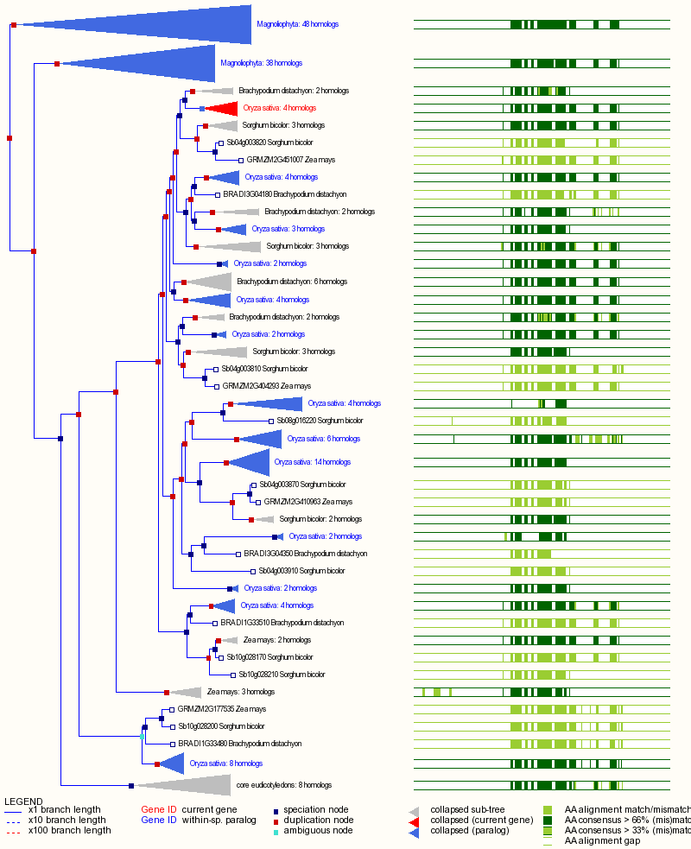
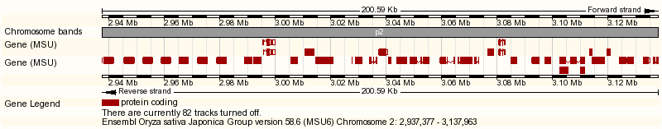
Tandem Duplicate Detection
Species | Clusters | Genes | Largest | Function
Rice japonica | 2519 | 7054 | 24 | phytosulfokine receptor-like (LRR-kinase receptor)
Sorghum | 2182 | 5927 | 19 | Chalcone-stilbene synthase like
Maize | 1871 | 4564 | 22 | DUF1754 (domain of unknown function)
Arabidopsis | 1738 | 4581 | 28 | ECA1 gametogenesis related family
LRR-Kinase species-specific expansions
Adjacent paralogs with no more than 2 intervening unrelated gene
Increase gene dosage
Diversifying selection
Often species-specific
LRR-Kinase cluster in rice

Slide 20
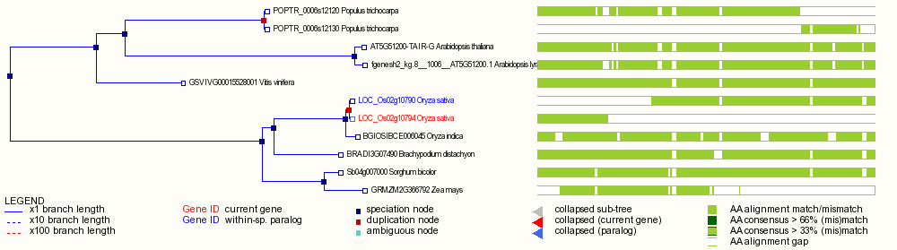
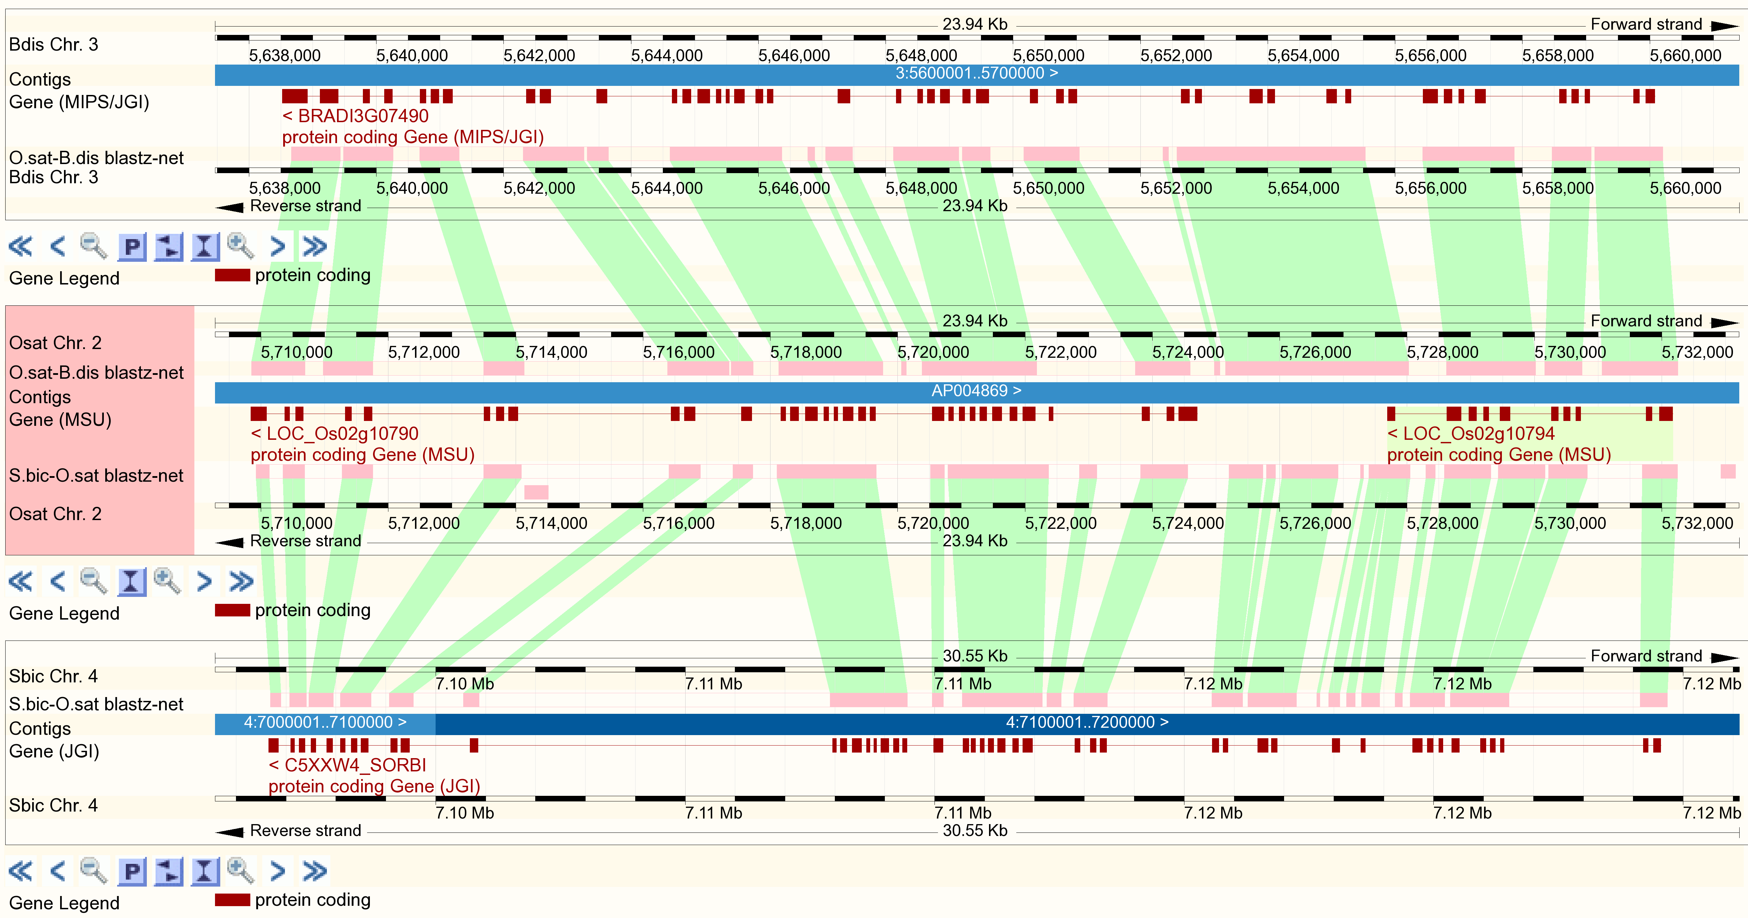
Automated Detection of Split Genes
Special class of “paralog” since Ensembl 58
Contiguous split paralog: Non-overlapping, nearby (<1 Mb), same strand
Putative split paralog: Non-overlapping, different regions (e.g. scaffolds)
Species | PutativeSplit Genes
Populus trichocarpa | 1181
Sorghum bicolor | 1087
Oryza sativa Japonica | 916
Vitis vinifera | 520
Oryza sativa Indica | 365
Zea mays | 280
Arabidopsis lyrata | 202
Arabidopsis thaliana | 137
Brachypodium distachyon | 101
Genome alignment confirms inconsistent annotation
Notes:
http://www.gramene.org/Oryza_sativa/Component/Gene/Web/ComparaTree?_rmd=3f4d;collapse=;db=core;g=LOC_Os02g10794;r=2:5727688-5732172;t=LOC_Os02g10794.1;export=png
http://www.gramene.org/Oryza_sativa/Component/Location/Web/MultiBottom?_rmd=d538;db=core;g=LOC_Os02g10794;r=2:5709278-5733216;r1=3:5637466-5661404:1;r2=4:7095576-7126123;s1=Brachypodium_distachyon;s2=Sorghum_bicolor;t=LOC_Os02g10794.1;export=png-5

Slide 21
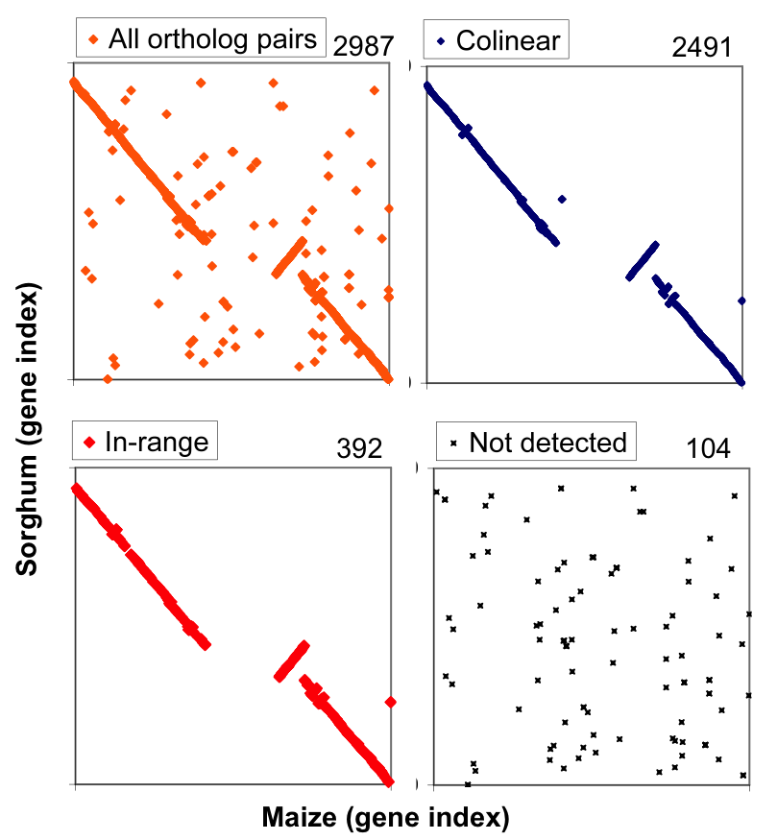
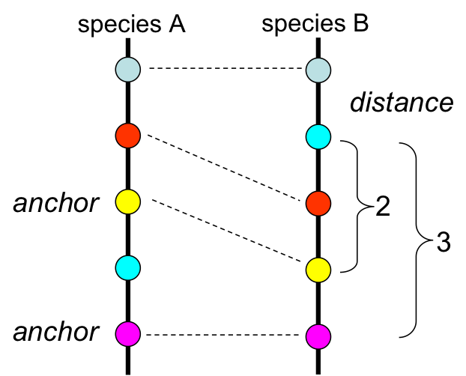
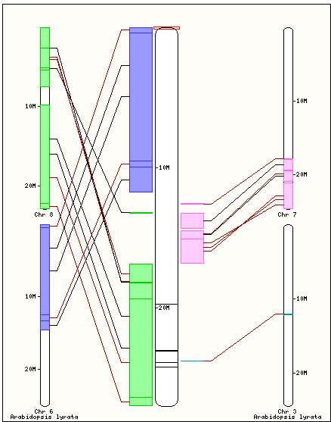
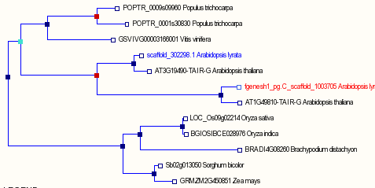
Gene-Centered Synteny Build
2010: Implemented with automated pipeline runnables
Release 31: monocots
Release 32: dicots
Compara Orthologs
Collinear mappings (DAGchainer)
“in-range” mappings near collinear anchors
Map
Oryza sativa Japonica | O.jap
Brachypodium distachyon | YES | B.dis
Sorghum bicolor | YES | YES | S.bic
Arabidopsis thaliana | - | - | - | A.tha
Arabidopsis lyrata | - | - | - | YES | A.lyr
Vitis vinifera | - | - | - | YES | YES | V.vin
Poplar trichocarpa | - | - | - | YES | YES | YES | P.tri
Notes:
http://www.gramene.org/Arabidopsis_lyrata/Gene/Compara_Tree?collapse=;db=core;g=fgenesh1_pg.C_scaffold_1003705;r=1:25911262-25913616;t=fgenesh1_pg.C_scaffold_1003705

Slide 22
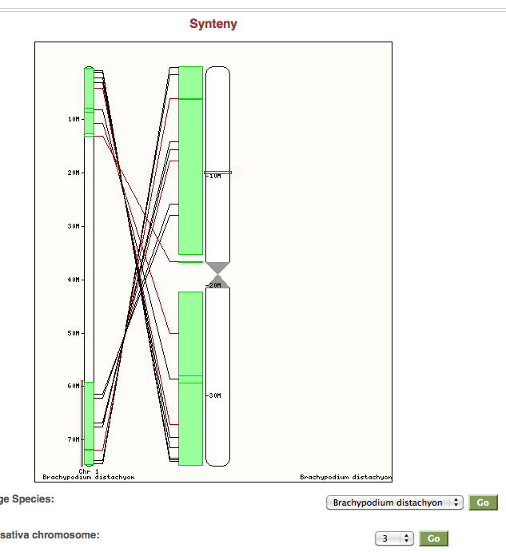
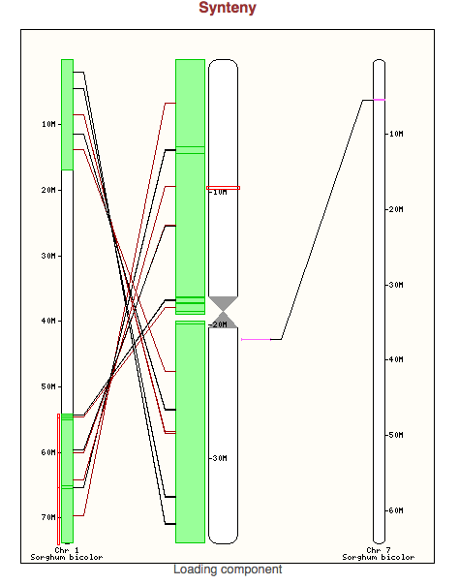
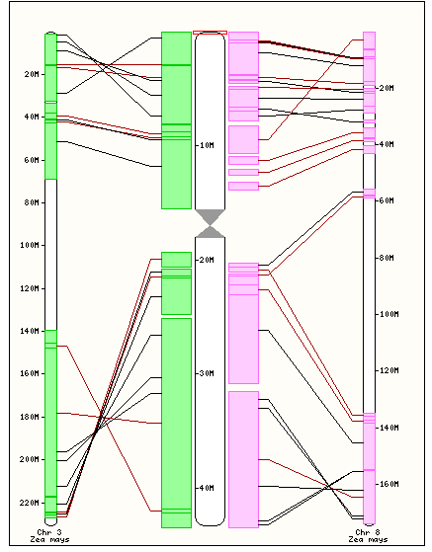
Synteny View
Rice vs Brachypodium
Rice vs Sorghum
Rice vs Maize

Slide 23
Oryza-Centered Trees
Trees for all OGE 3S genomes, plus O. sativa, sorghum, Brachypodium, Arabidopsis
Oryza phylogeny still controversial
How to represent polyploids?
O. minuta(BB), O. minuta(CC), or O. minuta(BBCC)
Supertree analysis provided by Mike Sanderson
(1) Ge et al. 1999, (2) Zou et al. 2008,
(3) Tang et al. 2009, and (4) Cranston et al. 2010.
Notes:
Figure cshl_5. Species phylogeny constructed by Michael Sanderson using a supertree approach and used as the input species tree for the Oryza-centered Compara GeneTree analysis.

Slide 24
Counts of Genes Incorporated into Trees.
23,612 Trees in all
2988 Containing any OGE 3S
677 Containing all OGE 3S species

Slide 25
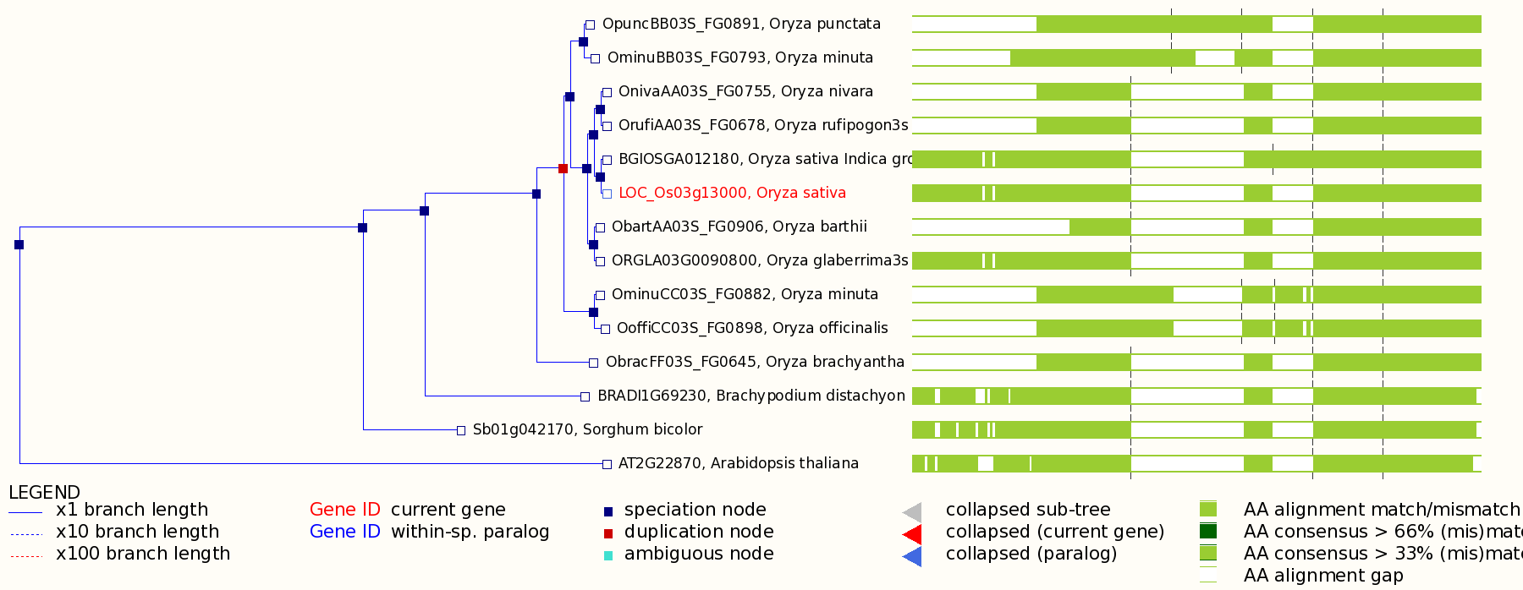
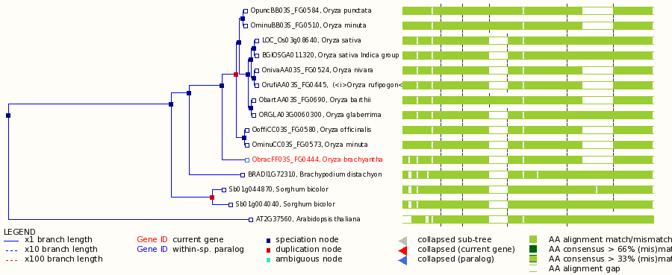
Example Trees
Notes:
Figure cshl_6. Example gene tree for the Oryza 3S genomes. The gene family is a GTP-binding protein, according to the MSU gene description and InterPro domains for the rice gene. The topology is as expected. However note the improperly classified duplication node, possibly the result of representing the O. minuta subgenomes as a single species. URL: http://dev.gramene.org/Oryza_sativa/Gene/Compara_Tree/pan_compara?collapse=;db=core;g=LOC_Os03g13000;r=3:7021842-7025173

Slide 26
Ortholog/homolog Results
HOMOLOGY COUNTS
 | Oba | Obr | Ogl | Omi | Oni | Oof | Opu | Oru | ath | bdi | oin | osa | sbi
Oba | 565 | 1253 | 1579 | 1600 | 1602 | 1458 | 1459 | 1428 | 1513 | 1563 | 1822 | 1824 | 1604
Obr | 1250 | 429 | 1231 | 1337 | 1227 | 1228 | 1222 | 1116 | 1426 | 1461 | 1511 | 1502 | 1484
Ogl | 1513 | 1174 | 432 | 1555 | 1425 | 1414 | 1405 | 1246 | 1491 | 1578 | 1821 | 2015 | 1602
Omi | 2762 | 2331 | 2808 | 3171 | 2672 | 2868 | 2753 | 2377 | 2868 | 3021 | 3365 | 3380 | 3120
Oni | 1574 | 1209 | 1473 | 1526 | 572 | 1399 | 1394 | 1420 | 1493 | 1543 | 1835 | 1825 | 1605
Oof | 1465 | 1242 | 1495 | 1875 | 1425 | 670 | 1508 | 1245 | 1525 | 1636 | 1808 | 1813 | 1682
Opu | 1468 | 1235 | 1477 | 1773 | 1426 | 1490 | 614 | 1274 | 1519 | 1594 | 1771 | 1777 | 1649
Oru | 1468 | 1152 | 1342 | 1425 | 1475 | 1287 | 1300 | 570 | 1421 | 1472 | 1670 | 1670 | 1503
ath | 2056 | 1965 | 2096 | 2225 | 2094 | 2007 | 2007 | 1831 | 15822 | 16034 | 16119 | 15930 | 16367
bdi | 1842 | 1751 | 1951 | 2074 | 1821 | 1933 | 1900 | 1648 | 20714 | 18248 | 21921 | 22265 | 22811
oin | 2572 | 2163 | 2639 | 2853 | 2581 | 2597 | 2520 | 2293 | 25478 | 25159 | 29157 | 32599 | 27872
osa | 2425 | 2036 | 2736 | 2863 | 2487 | 2557 | 2484 | 2229 | 24363 | 24851 | 32565 | 42115 | 28539
sbi | 2257 | 2122 | 2348 | 2726 | 2317 | 2448 | 2403 | 2065 | 24205 | 24873 | 26734 | 27608 | 26023
ORTHOLOGY COUNTS
 | Oba | Obr | Ogl | Omi | Oni | Oof | Opu | Oru | ath | bdi | oin | osa | sbi
Oba | 0 | 1253 | 1579 | 1600 | 1602 | 1458 | 1459 | 1428 | 1513 | 1563 | 1822 | 1824 | 1604
Obr | 1250 | 0 | 1231 | 1337 | 1227 | 1228 | 1222 | 1116 | 1426 | 1461 | 1511 | 1502 | 1484
Ogl | 1513 | 1174 | 0 | 1555 | 1425 | 1414 | 1405 | 1246 | 1491 | 1578 | 1821 | 2015 | 1602
Omi | 2762 | 2331 | 2808 | 0 | 2672 | 2868 | 2753 | 2377 | 2868 | 3021 | 3365 | 3380 | 3120
Oni | 1574 | 1209 | 1473 | 1526 | 0 | 1399 | 1394 | 1420 | 1493 | 1543 | 1835 | 1825 | 1605
Oof | 1465 | 1242 | 1495 | 1875 | 1425 | 0 | 1508 | 1245 | 1525 | 1636 | 1808 | 1813 | 1682
Opu | 1468 | 1235 | 1477 | 1773 | 1426 | 1490 | 0 | 1274 | 1519 | 1594 | 1771 | 1777 | 1649
Oru | 1468 | 1152 | 1342 | 1425 | 1475 | 1287 | 1300 | 0 | 1421 | 1472 | 1670 | 1670 | 1503
ath | 2056 | 1965 | 2096 | 2225 | 2094 | 2007 | 2007 | 1831 | 0 | 16034 | 16119 | 15930 | 16367
bdi | 1842 | 1751 | 1951 | 2074 | 1821 | 1933 | 1900 | 1648 | 20714 | 0 | 21921 | 22265 | 22811
oin | 2572 | 2163 | 2639 | 2853 | 2581 | 2597 | 2520 | 2293 | 25478 | 25159 | 0 | 32599 | 27872
osa | 2425 | 2036 | 2736 | 2863 | 2487 | 2557 | 2484 | 2229 | 24363 | 24851 | 32565 | 0 | 28539
sbi | 2257 | 2122 | 2348 | 2726 | 2317 | 2448 | 2403 | 2065 | 24205 | 24873 | 26734 | 27608 | 0

Slide 27
Protein Length Correlation
Pairwise comparison of Fgenesh length to top-hit MSU6 length
Total ratio = 0.94
Notes:
Figure cshl_2. Pairwise comparisons of peptide length between Fgenesh models and their best aligning O. sativa gene model as determined by Blastp. Protein sizes are generally perfectly correlated. Points above the trend indicate protein sizes that are longer in rice than the Fgenesh model. Below the trend line, the Fgenesh model has the greater length.

Slide 28
Gene-based Synteny
Notes:
Figure cshl_3. Syntenic relationships between Fgenesh models and best-aligning homolog in MSU6.0.

Slide 29
Chromosomal Distributions
O. glaberrima
O. barthii
O. nivara
O. brachyantha
Telomere to centromere axis
Expected rise of repeat content, decline of gene content, decline of alignment homology
Notes:
Figure cshl_4. Distribution of genes, repeats, and conserved bases along the 3S chromosomes. Upper left: O. glaberrima. Upper right: O. barthii. Bottom left: O. nivara. Bottom right: O. brachyantha.

Slide 30
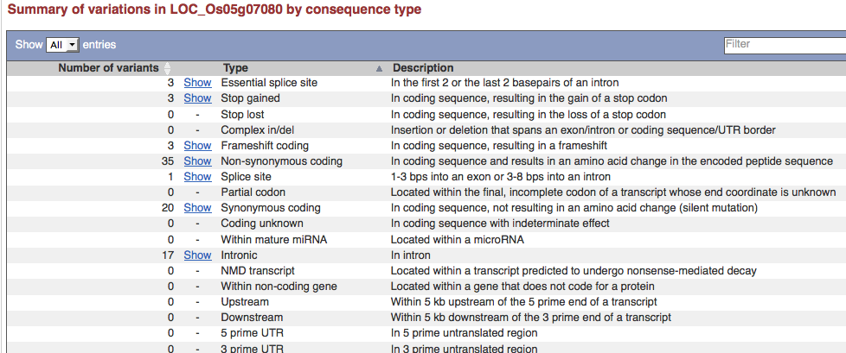
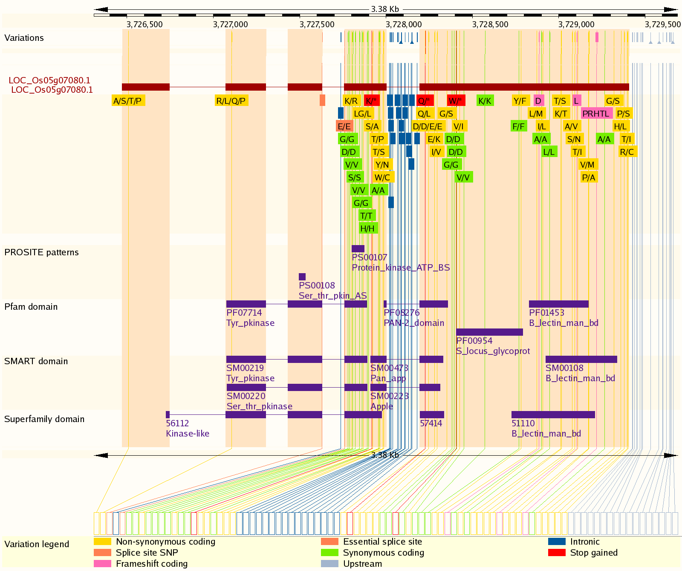
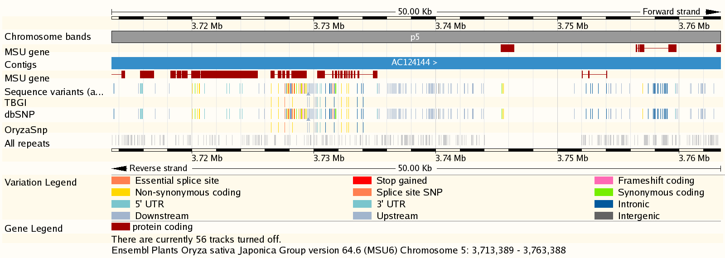
SNP View: Functional consequences of polymorphism
Synonymous coding
Non-synonymous coding
Stop gain/loss
Splice site
UTR
Intronic
Variation from
View in context of protein functional domains
dbSNP, OryzaSNP
McNally, K et al. PNAS 2009 - ~160K SNPs x 20 diversity rice accessions, mapped from IRGSP4 to MSU6
Zhao et al PLoS One 2010 - 1311 SNPs x 395 accessions.
Notes:
Ken remember the variation data in Core is different.

Slide 31
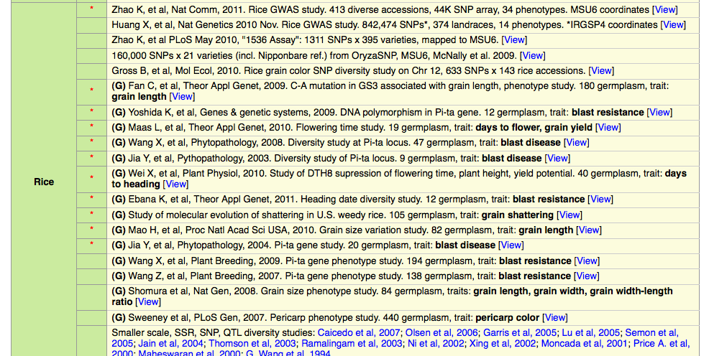
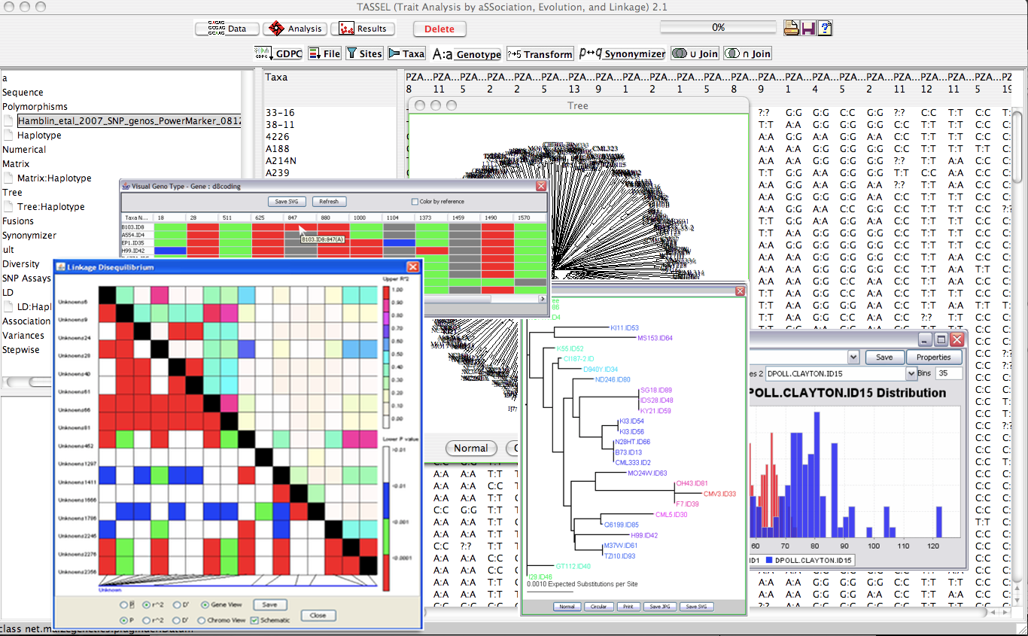
Rice Diversity Module
Launch Tassle for GWAS: Ed Buckler Terry Casstevens
Susan McCouch lab

Slide 32
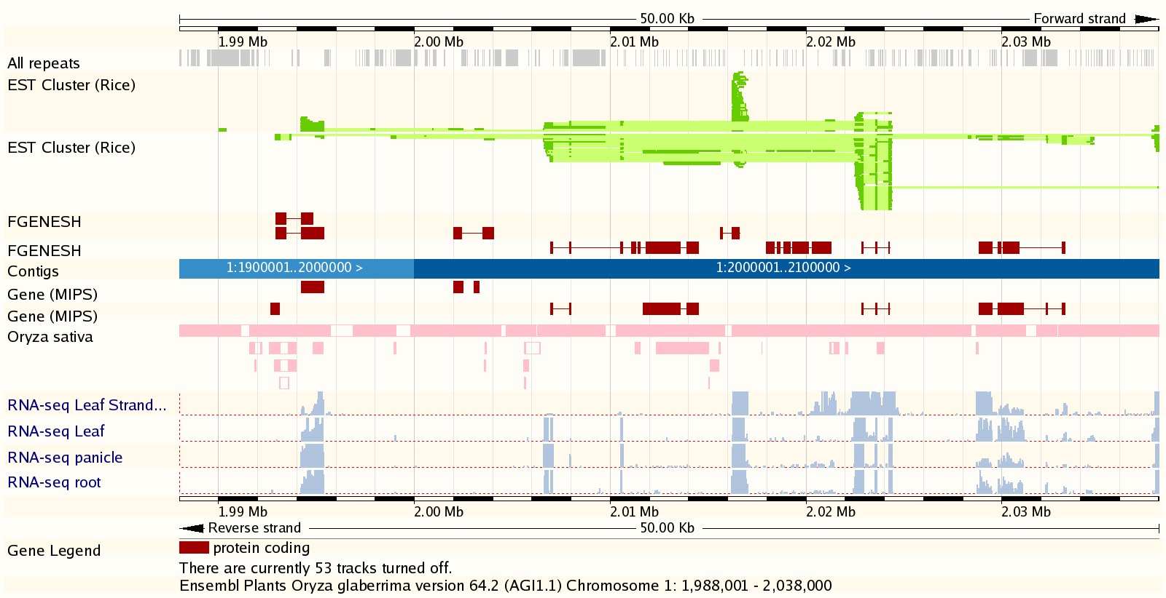
O. glaberrima Browser (Rod Wing AGI)
RNA-seq data: Yiesoo Yu and Xiang Song (AGI)
Notes:
http://www.gramene.org/Oryza_glaberrima/Location/View?r=1:8001-18000#r=1:1988001-2038000

Slide 33



Metabolic Pathways
Pankaj Jaiswal (Oregon State)
http://www.gramene.org/pathway/

Slide 34

New Oryza Pages
Highlights this genus with images, phylogeny, geographic origin, & traits of interest
Entry points to browsers, germplasm, markers, & taxonomy ontology

Slide 35
Future
O. brachyantha reference (Mingsheng Chen)
Short arm sequences:
O. glumaepatula
O. meridionalis
O. granulata
Leeresia perrieri
O. glaberrima diversity data (Rod Wing)
I-OMAP Reference genomes after submission to GenBank

Slide 36
Oryza Genome Evolution Project (OGE)
Arizona Genomics Institute (U. of Arizona)
Rod Wing, PI
Yeisoo Yu
Raju Jetty
Jose Luis Goioechea
Carlos Maldonado
Xian Song
Muhua Wang
Chuanzhu Fan (Wayne State U)
Julie Jacquemin
Dave Kudrna
Steve Rounsley (Dow)
Andrea Zuccolo
University of Arizona
Michael Sanderson
Derrick Zwickl
University of Chicago
Manyuan Long
University of Georgia
Scott Jackson
University of Maryland
Carlos Machado
Cold Spring Harbor Lab
Doreen Ware
Sharon Wei
NSF Award #1026200
Notes:
Please note not all staffing is 100% on Gramene.

Slide 37
Gramene
CSHL
Doreen Ware
Sharon Wei
Ken Youens-Clark
Jim Thomason
Marcela Monaco
Will Spooner
Shiran Pasternak
Aaron Chuah
Cornell University
Susan McCouch
Genevieve DeClerck
Karthikeyan Athikkattuvalasu
Ed Buckler
Terry Casstevens
Charles Chen
Oregon State University
Pankaj Jaiswal
Vindhya Amarasinghe
Palitha Dharmawardhana
Collaborator
European Bioinformatics Institute (EBI)
Paul Kersey
Paul Derwent
Dan Staines
NSF award #0703908 and partial support from USDA and USDA-ARS
www.plants.ensembl.org
Notes:
Please note not all staffing is 100% on Gramene.

Slide 38






Oryza nivara Species Page
Accession: IRGC100
Genome: AA
Origin: India
Useful Traits: Resistance to grassy stunt virus and BI
Maps
Markers and sequences
Taxonomy ontology
Germplasm
The Browser
Notes:
http://www.gramene.org/Oryza_nivara/Location/View?r=nivara_3s:8001-33000

Slide 39
Description
.
About Oryza sativa
Rice
Oryza sativa (rice) is the staple food for 2.5 billion people, and, after maize, the grain with the second highest worldwide production. In addition to it's agronomic importance, O. sativa is also an important biological model species for monocot plants, and major cereal crops such as maize, wheat, barley and sorghum. O. sativa has a compact genome of approx. 500 Mbase (n=12) compared with the multi-gigabase genomes of maize, wheat and barley. [more].
Genome Sequencing and Gene Prediction (MSU6)
Two sub-species of O. sativa have been sequenced; the Japonica Group, and the Indica Group. This browser presents the Japonica sequence, which has become the most widely used reference genome for rice. A separate browser presents the Indica sequence.
Whilst the completion of the rice genome (O. sativa Japonica Group cultivar Nipponbare) sequencing was announced by the International Rice Genome Sequencing Consortium (IRGSP) in 2002, the assembly was not published until 2005 [1]. An assembly of the draft IRGSP sequence was, however, made available by the TIGR Rice Genome Annotation Project somewhat earlier [2]. The sequencing strategy followed a BAC-by-BAC approach, with clones anchored to chromosomes via genetic and physical maps. This browser uses the sixth iteration of the TIGR, latterly MSU assembly, released in January 2009.[more]
MSU's gene prediction pipeline uses a number of ab initio methods, EST/mRNA alignments, and the PASA alignment assembler. [more].
Gramene/Ensembl Genomes Annotation
Additional annotations generated by the Gramene/Ensembl Genomes projects include:
The standard set of Gramene analyses detailed here.
Phylogenetic gene trees and whole-genome alignments with several plant and metazoan species, using Ensembl's Compara pipeline.
Mapping of Oryza sativa variation data from NCBI dbSNP onto the genome assembly. Includes OryzaSNP large scale SNP variation study (McNally, K et al. PNAS 2009) - ~160K SNPs x 20 diversity rice accessions, mapped from IRGSP4 to MSU6. Now also includes a further SNP variation study (Zhao et al PLoS One 2010) - 1311 SNPs x 395 accessions.
Probes from the Rice Genome Array for two rice cultivars were aligned to the genome.
This release of the assembly (MSU6) for Oryza sativa is composed of 3522 clones with a total length of 488.0 Mb assembled into 16 chromosomes with a total length of 374.3 Mb.
Links
Gramene/EnsemblGenomes browser for Oryza sativa Indica Group
Gramene species page for Oryza
MSU Rice Genome Annotation Project
International Rice Genome Sequencing Consortium (IRGSP)
References
International Rice Genome Sequencing Project.The map-based sequence of the rice genome. Nature. 2005;436(7052):793-800. PubMed ID: 16100779
Yuan Q, Ouyang S, Liu J, et al. The TIGR rice genome annotation resource: annotating the rice genome and creating resources for plant biologists. Nucleic Acids Res. 2003;31(1):229-233. PubMed ID: 12519988
Ouyang S, Zhu W, Hamilton J, et al. The TIGR Rice Genome Annotation Resource: improvements and new features. Nucl. Acids Res. 2007;35(suppl_1):D883-887. PubMed ID: 17145706
Zhao K, Wright M, Kimball J, et al. Genomic diversity and introgression in O. sativa reveal the impact of domestication and breeding on the rice genome. PubMed ID: 20520727

